Slide 1
FY2024 Approved Legislative Appropriations vs.
FY 2024 Budget Handbill & Printed National Budget
Presented by
Senator Amara Konneh
Chairman, Public Accounts & Audits Committee
September 10, 2024

Slide 2
Legislative Authority and Responsibility over the National Budget
Article 34 (d) of the Liberian Constitution gives the Legislature the power to:
  Make appropriations for the fiscal governance of the Republic.
Section 20 of the Amendment and Restatement of the PFM Act of 2009 gives the Legislature the power to:
  Review, modify, and approve the Proposed Budget from the President
  Adopt the Annual Appropriations Act for one fiscal year (National Budget) which shall lapse at the end of the fiscal year for which it is approved.
Section 23 of the same Act gives the legislature the power to:
  Modify and approve a supplementary Budget from the President

Slide 3
Approved Budget after the Legislature Adjustments to President’s Draft Budget
The President submitted a draft budget of $692.4M on March 12, 2024. After Legislative adjustments of $46.5M, the HOR approved the budget at $738.9M and concurred with the Senate without modifications on April 30, 2024.

Slide 4
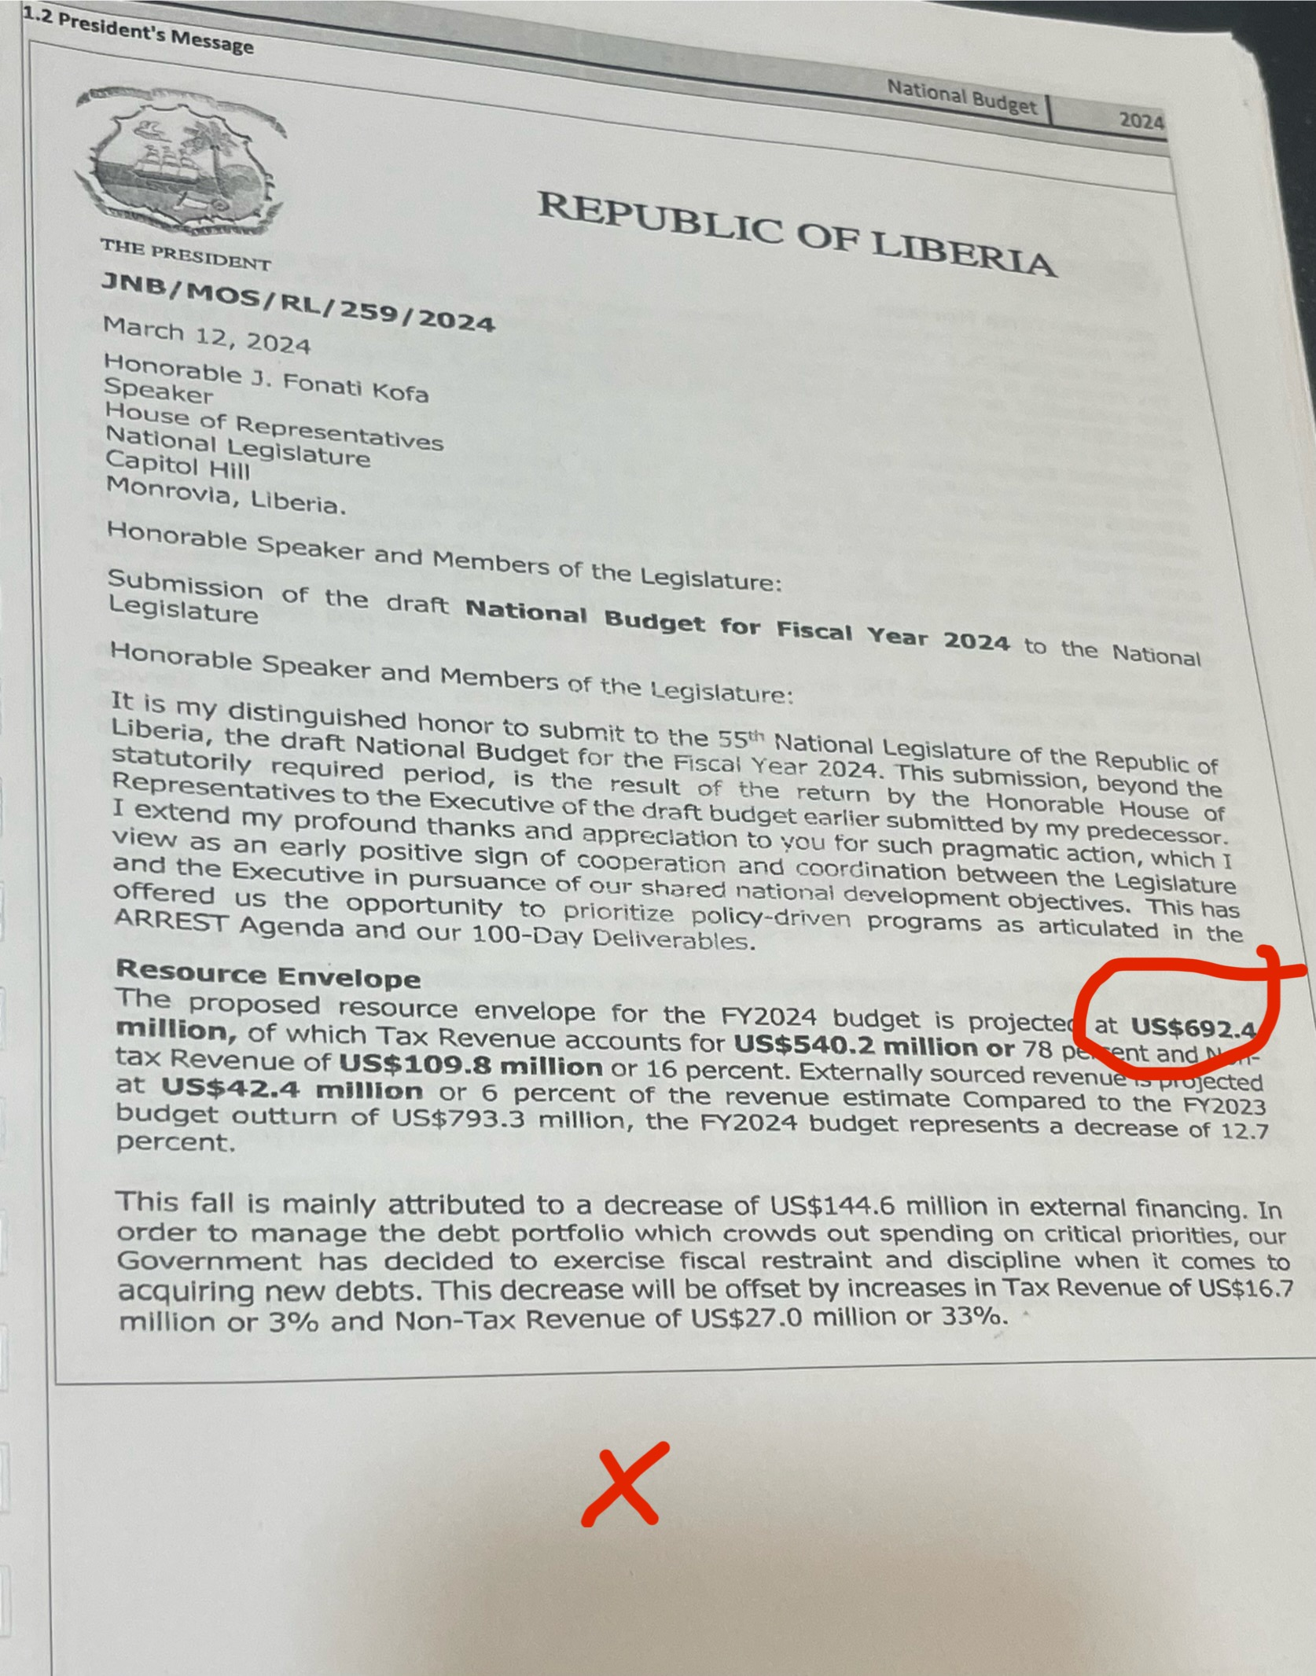
Exhibit 1: President’s letter communicating his draft budget proposals to the Legislature

Slide 5
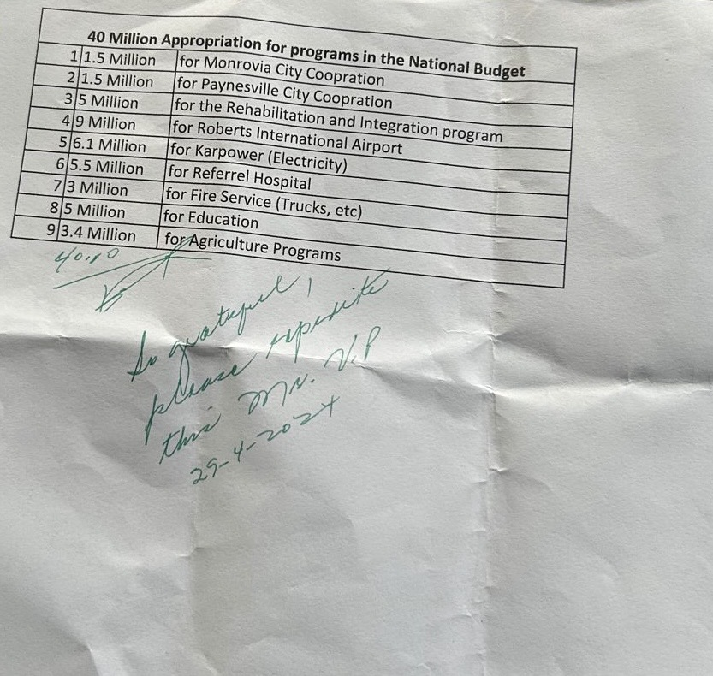
Exhibit 2: Spreadsheet with the President’s unofficial request for allocation of $40 million of new revenue
President’s unofficial request signed on April 29, 2024, based on the rollover of the redemption of treasury instruments negotiated by the Legislature with commercial banks and IMF to FY 2025 once the GOL can pay the interest and charges in full, the treasury instruments should be rolled over. This saved US$ 45.6 million for reallocation.

Slide 6
Priorities of the Legislature Adjustments to Draft Budget
Based on the Adjustments, the Legislature prioritized the following sectors:
Health +5.0M
Social Services +13.8M
Municipal Government +6.4M
Security +9.7M
Education +3.6M
Infrastructure +3.0M
Agriculture +3.0M

Slide 7
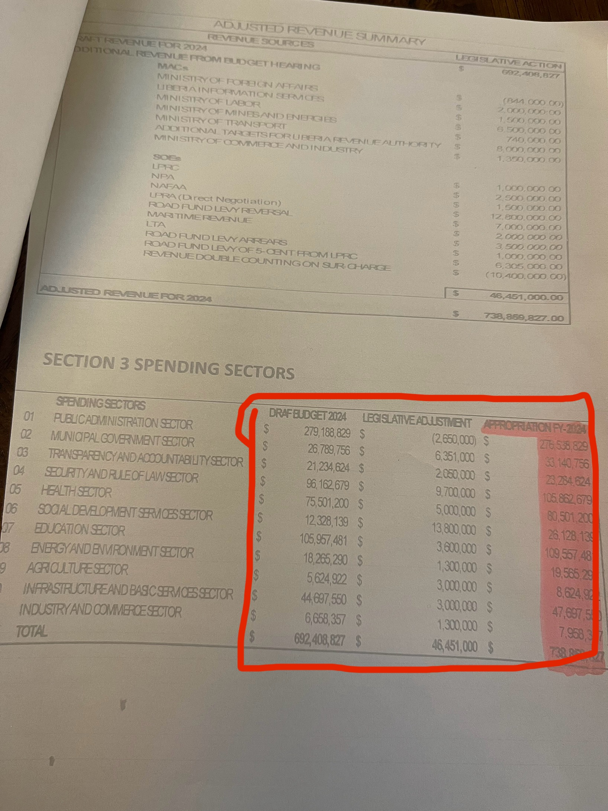
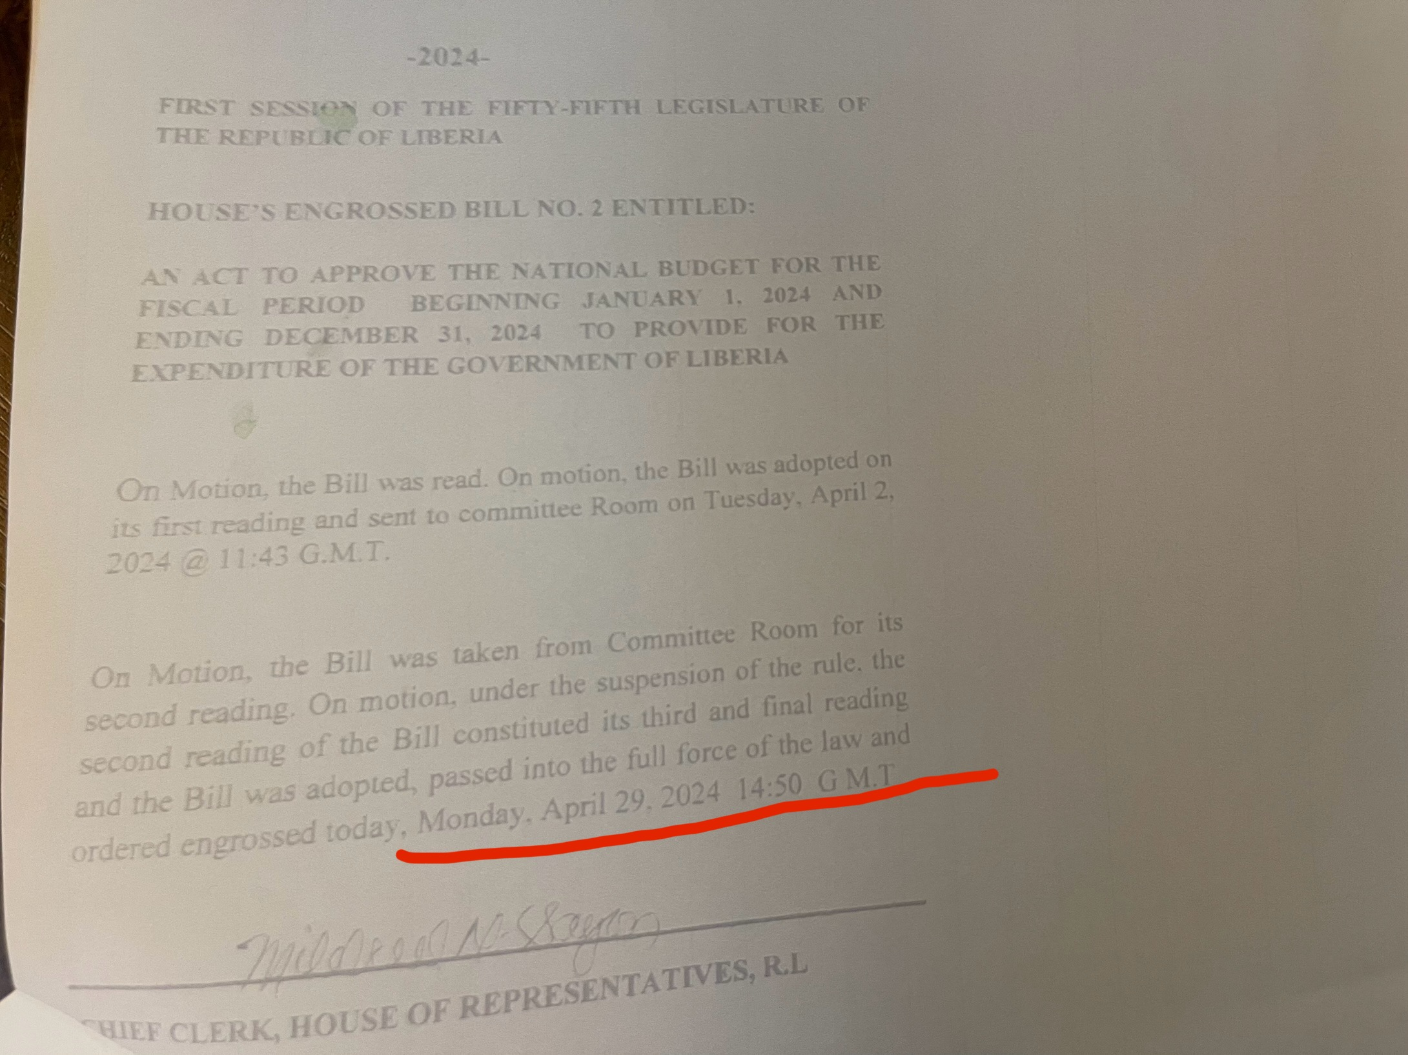
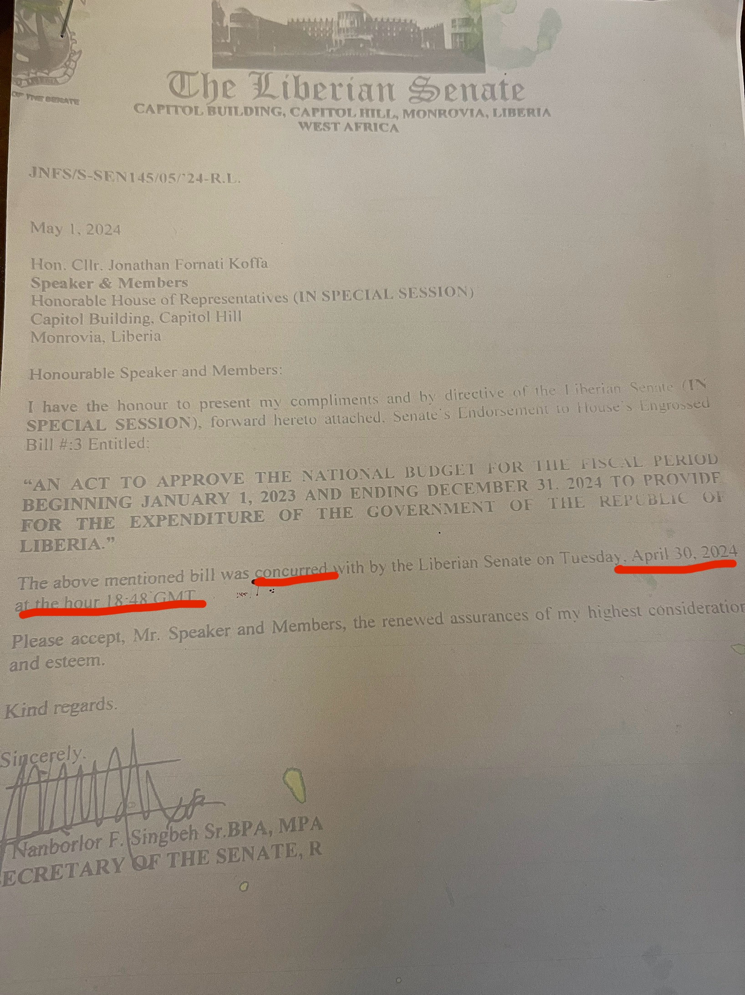
Exhibit 2: HOR Approved Budgets and Senate’s Concurrence

Slide 8
Deviations from the Approved Budget by the Executive
Two alterations re-prioritized the Budget Approved by the Legislature, transferring funding away from Public Administration, Transparency, and Health sectors while providing a meager 2.3% to Agriculture and 1.6% to Education.

Slide 9
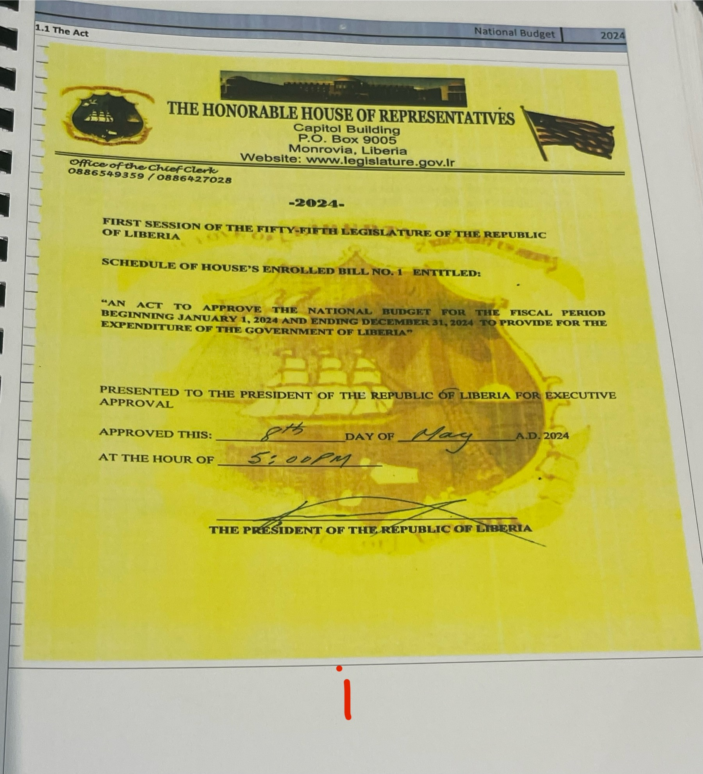
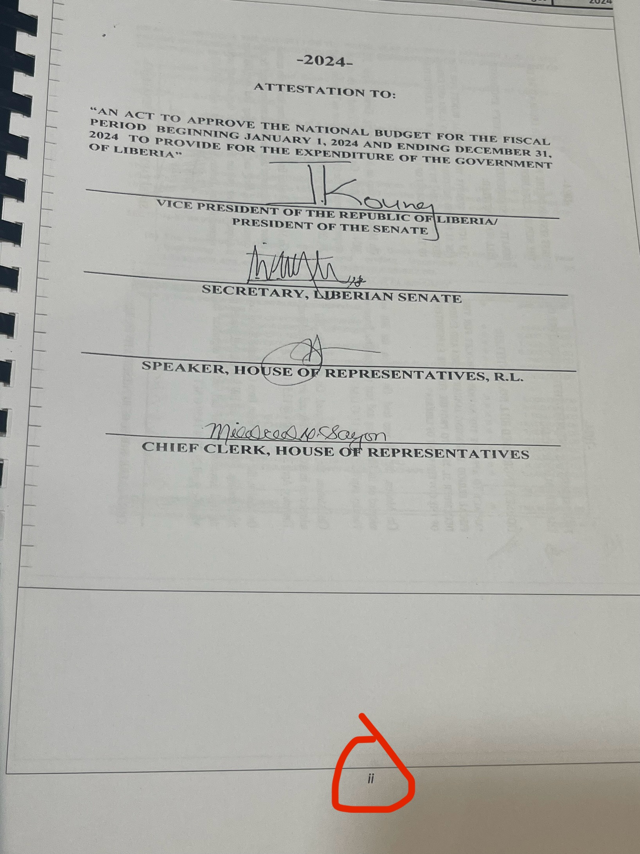
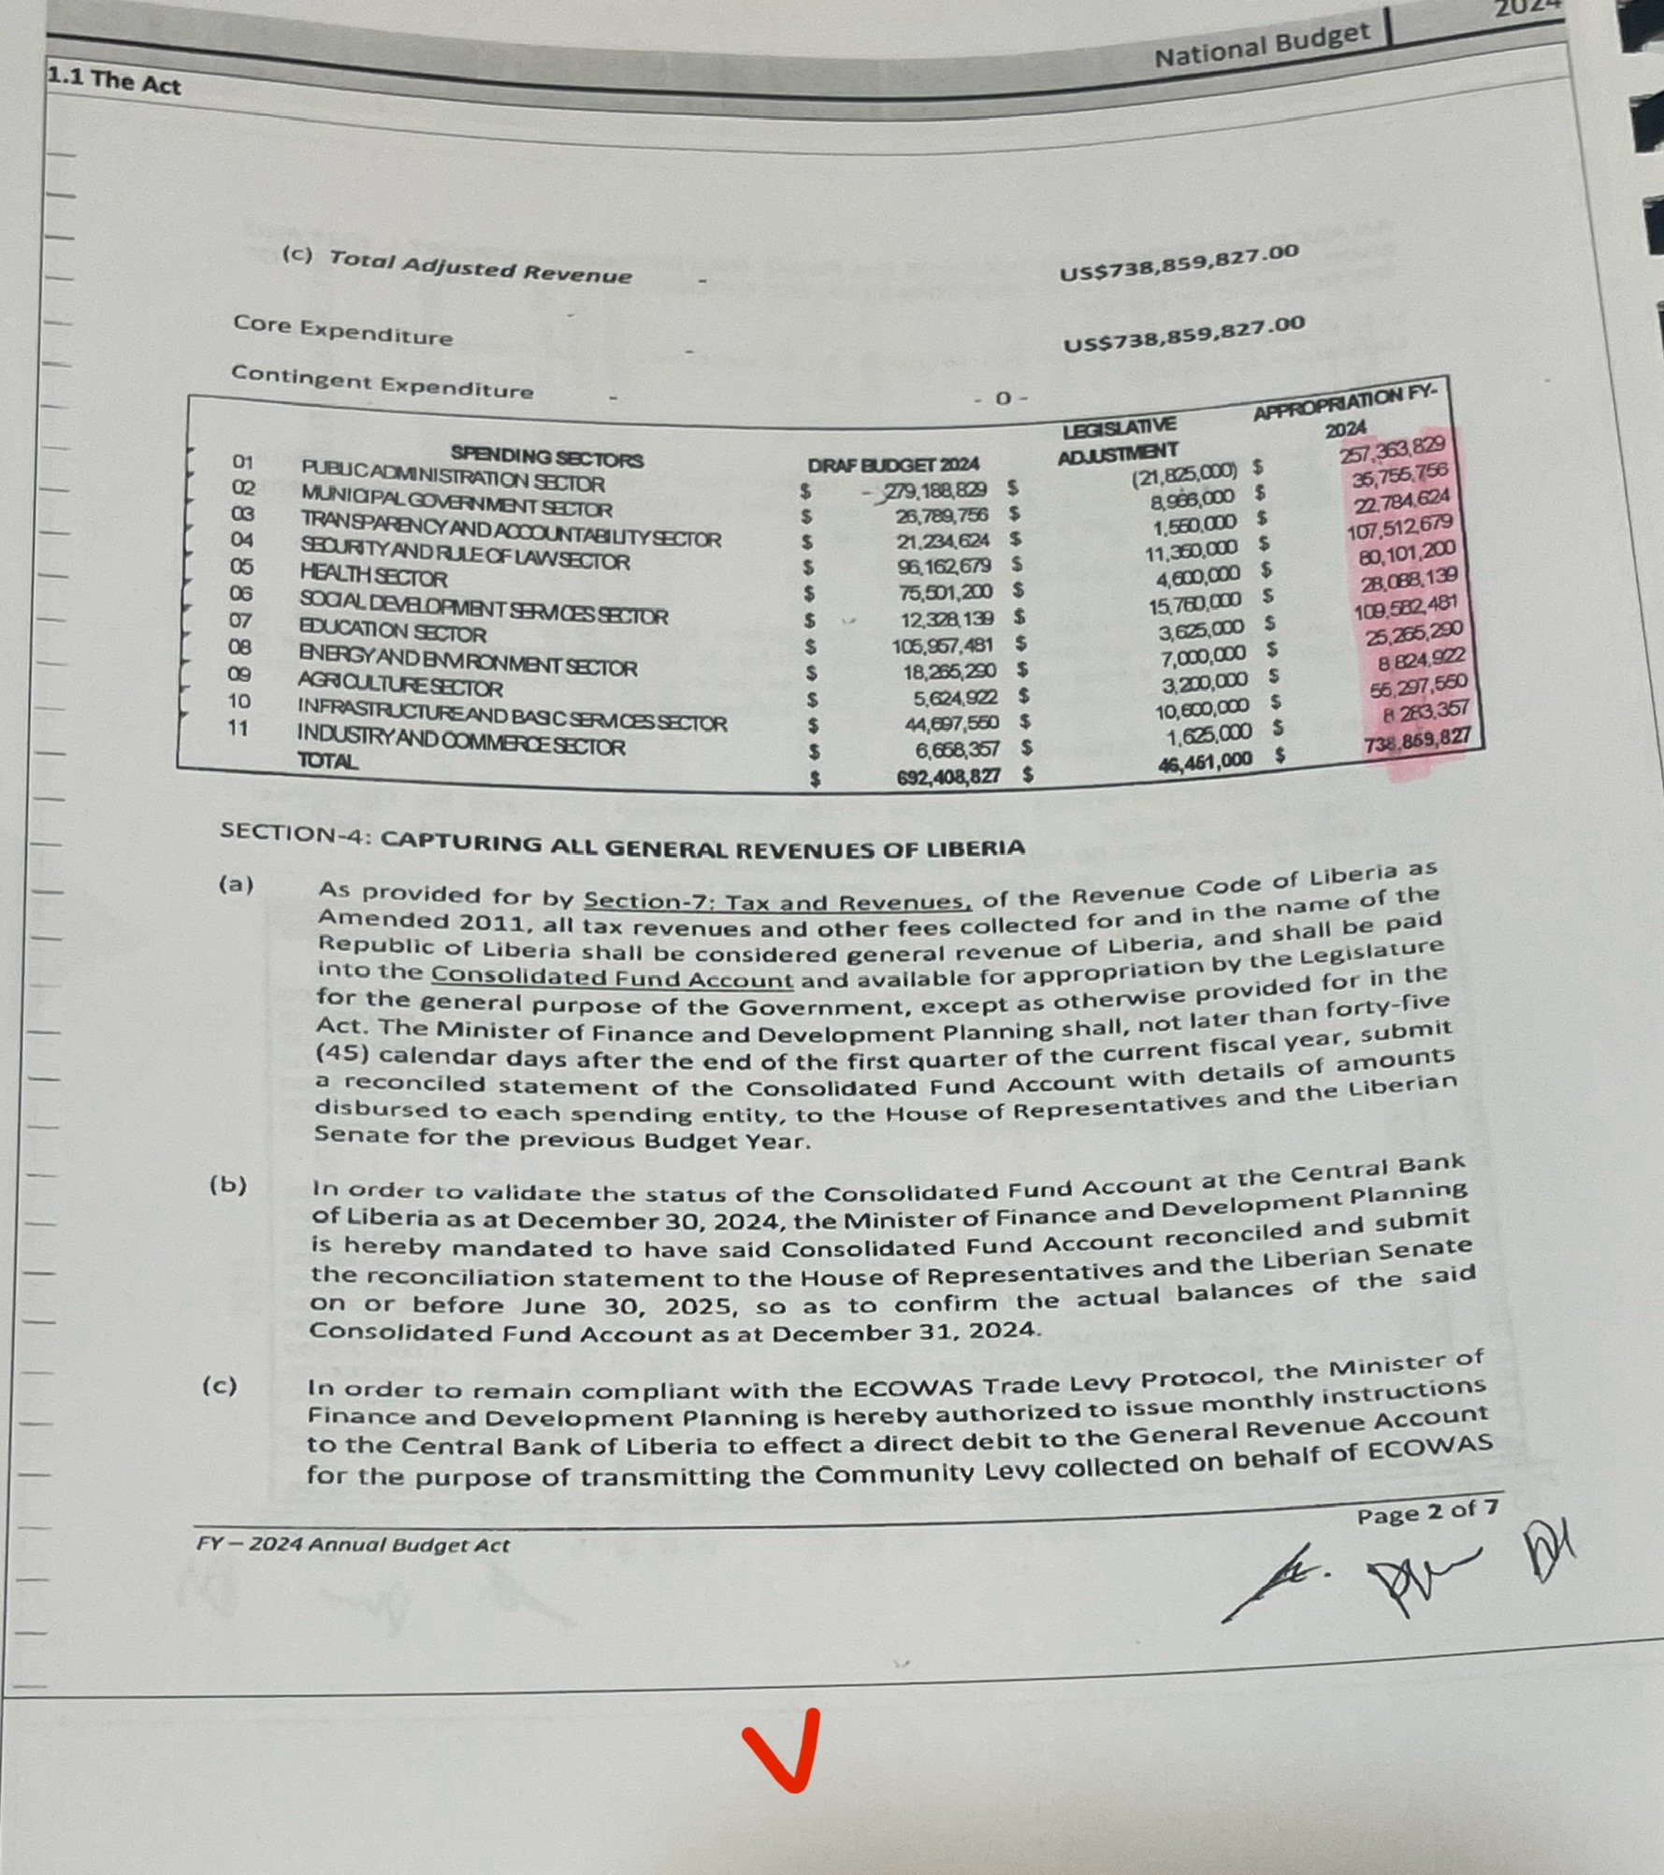
Exhibit 3: Alteration 1 in Budget Act

Slide 10
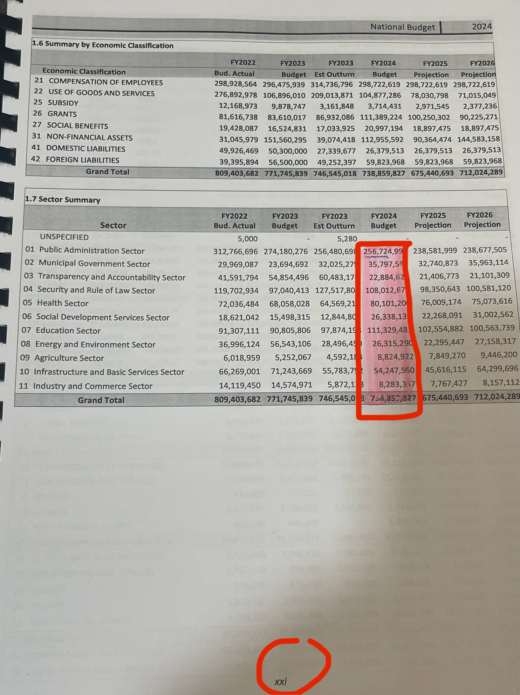
Exhibit 4: Alteration 2 in Published Budget Book

Slide 11
Two possible scenarios on the illegal alterations
Scenario 1: Some members of the Legislature made these adjustments – or instructed the Executive Branch to do so – after the Plenary, the Senate's highest decision-making body, ratified the budget. No individual or group of members in the Legislature has such authority, once a decision is made by the Plenary.
Scenario 2: The Executive Branch made these adjustments unilaterally, without the knowledge of the Senate. If this is true, it is illegal and an arguable sign that the Executive Branch is undermining the Senate's authority and disregarding the separation of powers enshrined in the Liberian Constitution. Not acting would continue the trend espoused by the previous administration to usurp the powers of the Senate.

Slide 12
Recommendations to the Senate on July 6, 2024
Direct that the Executive Branch republishes the budget to reflect the budget figures and allocations approved by the Senate Plenary and base all budget execution reports on the Legislature’s approved version of the budget.
Under Section 21, Subpart 1 of the PFM Act of 2009, as amended, summon the Minister of Finance and Development Planning to provide explanations for each alteration, detailing how it aligns with the government's declared fiscal objectives and "remains true to the spirit of allocation efficiency" as approved by the National Legislature on April 30, 2024.
Direct the MFDP to publish the Budget Execution Report for the Second Quarter based on the Legislature’s approved appropriations, not the draft or printed budget book for public consumption by July 31, 2024.
Launch a full-scale independent investigation by the GAC or LACC into the disbursements of these illegal adjustments to determine how they were spent. Members of the Executive Branch who committed this forgery or illegally changed an important national document should be sent to the Ministry of Justice for prosecution, while complicit senators must face the disciplinary censure of the Senate

Slide 13
THANK YOU!

